Slide 1
COVID-19 Vaccine and Adolescents
Alan Gross, PharmD, BCIDP
Infectious Diseases Pharmacist &
Clinical Associate Professor,
University of Illinois at Chicago College of Pharmacy

Slide 2
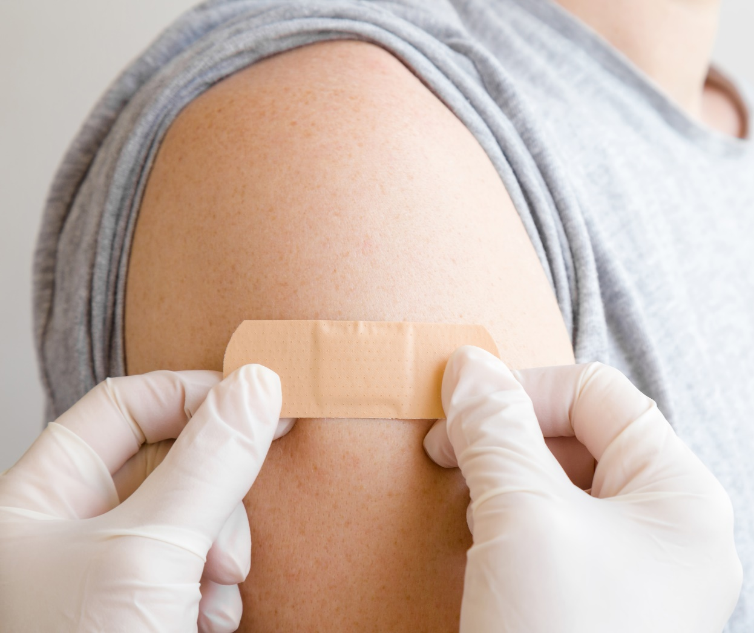
COVID-19 Vaccine
Use in adolescents 12 to 15 years-old
What should I know?
Does it work?
Is it safe?

Slide 3
Why should adolescents be vaccinated?
Even young people can get COVID-19 infection
Can cause serious illness or death
More people who get vaccine, the better to protect our communities
Goal is to reach herd immunity*
*Herd immunity occurs when a large portion of a community (the herd) becomes immune to a disease, making the spread of disease from person to person unlikely.
Notes:
Enough people become immune to a disease to make its spread unlikely
Entire community is protected, even those who are not themselves immune
Herd immunity is usually achieved through vaccination
Percent of community needed to get to herd immunity varies
Measles requires 95% of population be vaccinated
Polio requires 80% of population
COVID-19 Experts suggest that it requires 70 to 85% of population

Slide 4
What vaccine is authorized for adolescents?
Authorized: Pfizer BioNTech
Age groups: 12 years and older
Dose: Two doses (0.3 mL)
Frequency: 3 weeks apart
Route: Intramuscular
Contraindication Allergy to ingredients of vaccine
Notes:
Dosing is the same as with adults
Second dose can be administered up to 42 days after the first dose

Slide 5
What is mRNA vaccine?
How does mRNA work?
mRNA is normally found in the body
mRNA creates a blueprint for COVID-19 spike protein
Antibodies develop to the spike protein, creating immunity
Is mRNA technology new?
No, it has been researched for 10 years in cancer, flu and Zika virus
mRNA vaccines work off a blueprint; they can be created quickly
Traditional vaccines (Chickenpox, tetanus, flu) take longer

Slide 6
Want a clear understanding of how mRNA works?
Click on this link to watch a 2-minute video

Slide 7
More facts about the mRNA Vaccine
Cannot give someone COVID-19
no live virus that causes COVid-19
Does not interfere with DNA
mRNA never enters the inside of the cell (nucleus), where DNA is stored
Cells break down and eliminate mRNA after they use the instructions to produce the protein to protect the person

Slide 9
Pfizer Development of Vaccine
https://www.pfizer.com/science/coronavirus/vaccine/about-our-landmark-trial

Slide 10
COVID-19 Vaccine Efficacy-Adolescents
Clinical trial in adolescents
1,983 Volunteers
Age 12 – 15 years
1,005 received Pfizer COVID-19 vaccine
978 received Placebo
ACIP May 12, 2021 Presentation Slides | Immunization Practices | CDC

Slide 11
Results of studies
Vaccine 100% effective
No cases in vaccine treated group
16 cases (1.6%) in the placebo group
ACIP May 12, 2021 Presentation Slides | Immunization Practices | CDC

Slide 12
COVID-19 Vaccine Safety-Adolescents
Side effects – same as in adults and older teens
Side effects are mostly self-limited and mild to moderate
More common with second dose
Pain and redness at injection site (~87%), fever (10.1%) or fatigue (60.1%)
Nausea and Diarrhea (8%)
Headache (55%)
ACIP May 12, 2021 Presentation Slides | Immunization Practices | CDC

Slide 13
Scheduling the second dose
It is very important that adolescents receive BOTH doses of the COVID-19 vaccine
Full vaccination provides best protection
What if we miss the second appointment at 3 weeks?
Second dose can be given up to 6 weeks after the first dose

Slide 14
Helping your child after the COVID-19 Vaccine
Read the Vaccine Information Sheet to learn about side effects your child may experience.
Use a cool, damp cloth to help reduce redness, soreness and/or swelling at the place where the shot was given.
Reduce fever with a cool sponge bath.
After the vaccine, you may give your child pain or fever reducers if necessary.

Slide 15
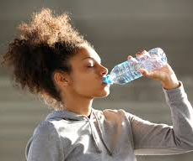
Helping your child after the COVID-19 Vaccine
Offer liquids more often. It is normal for some children to eat less during the 24 hours after getting vaccine.
Use a non-aspirin pain reliever for mild pain.
Pay extra attention to your child for a few days.
If you see something that concerns you, call your child’s doctor.

Slide 16
Other Vaccines are okay!
No need to space different vaccines
COVID-19 and other vaccines may be administered on the same day
Other vaccines can be given within 14 days of COVID-19 vaccine
ACIP May 12, 2021 Presentation Slides | Immunization Practices | CDC

Slide 17
COVID-19 vaccines and routine vaccines for school
Some adolescents may have missed or delayed vaccine appointments during the pandemic
All adolescents should receive back to school vaccines before classes start
Be sure to catch up on any vaccines missed
Check with your child’s doctor, or see the chart on the next slide
CDC Presentation
Notes:
Tdap down 19%
HPV down 19%
Meningococcal down 15%

Slide 19
If you want to determine your child’s vaccine needs-
Answer 7 quick questions to learn which vaccines your child may need.
Vaccines are recommended for children and adolescents based on age, health conditions, and other factors.
Click on the link to take the quiz https://www2a.cdc.gov/vaccines/childquiz/

Slide 20
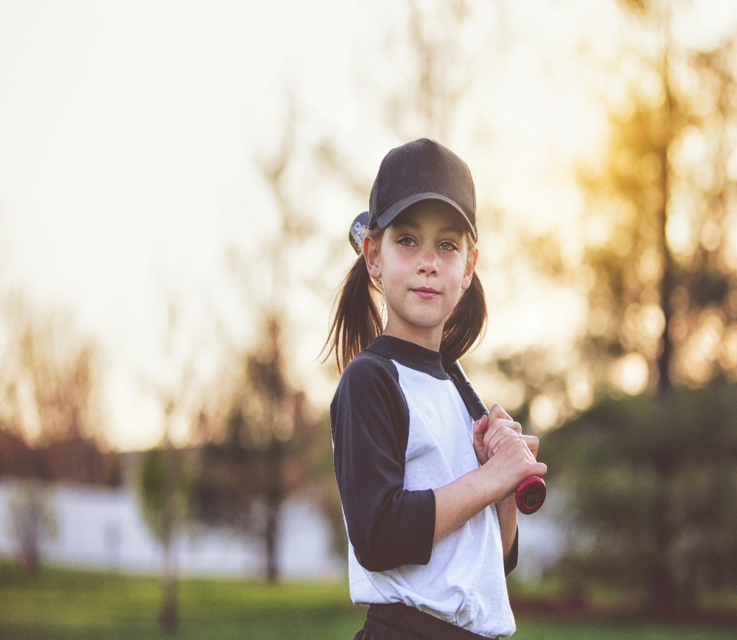
Let’s all work together
We all want to get things back to normal
Get everyone vaccinated!
Keep wearing masks when required
Use social distancing when you can
Wash your hands frequently

Slide 21
Resources
Psychology Today offers points on preparing children and their parents for vaccination against COVID-19.
https://www.psychologytoday.com/intl/blog/pain-explained/202104/preparing-kids-and-parents-covid-vaccines
Healthychildren.org from the American Academy of Pediatrics answers questions parents may have about the COVID-19 vaccine.
https://www.healthychildren.org/English/health-issues/conditions/COVID-19/Pages/The-Science-Behind-the-COVID-19-Vaccine-Parent-FAQs.aspx
The Autism Society of America created social stories to assist in preparing children for vaccination and other aspects of the pandemic.
https://www.covid19.autism-society.org/
Recommended list of vaccines from the Centers for Disease Control (parent-friendly) https://www.cdc.gov/vaccines/schedules/easy-to-read/adolescent-easyread.html#table-teen
Questionnaire for determining your child’s vaccines https://www2a.cdc.gov/vaccines/childquiz/

